Slide 1

Bike Riding Case Study Presentation
Presenter: Skillarchie Davis
Last Updated: 02/06/21

Slide 2
Presentation Flow
Project overview and goals
Key Findings
Recommendation
Question

Slide 3
Project overview and goals
The stakeholders want to know how do annual members and casual riders use Cyclitic bikes differently and how can this insight contribute to a solution where more casual riders will opt to becoming a member.

Slide 4
Key Findings

Slide 5
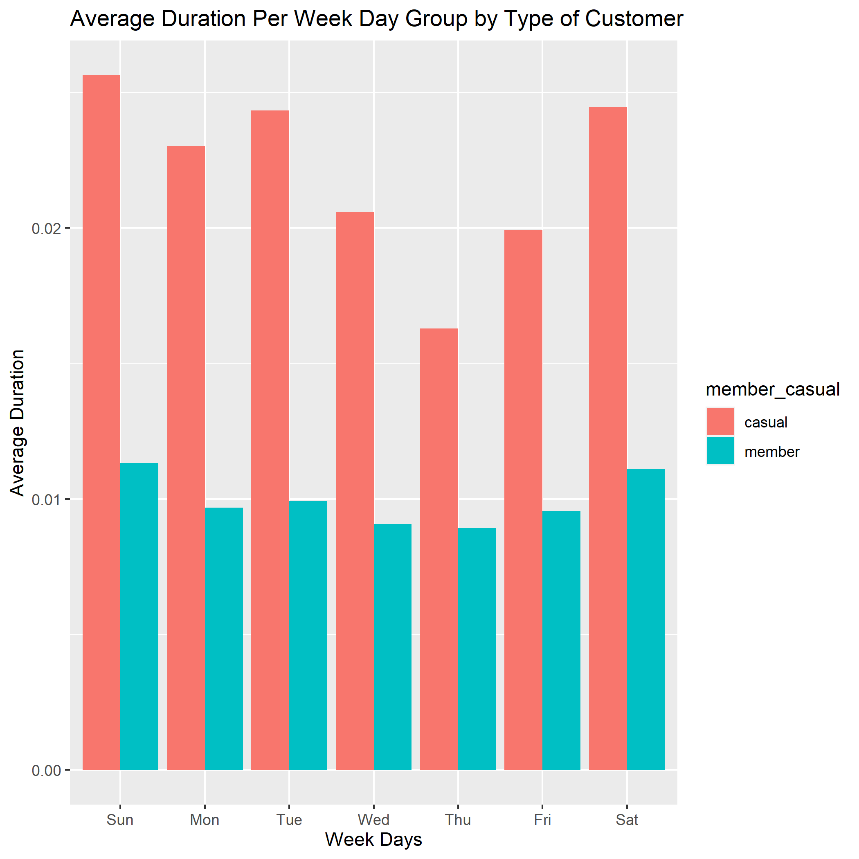
Casual Riders Travel longer distance

Slide 6
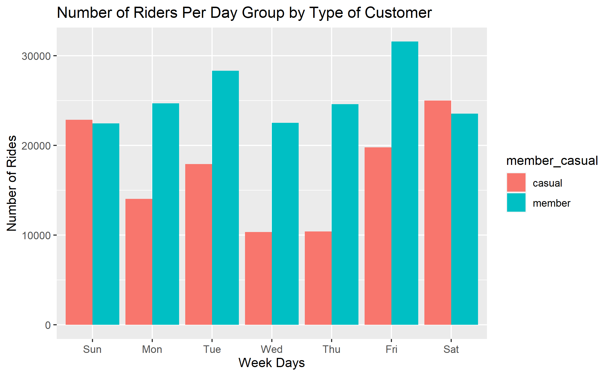
Casual Riders Travel More on Weekend

Slide 7
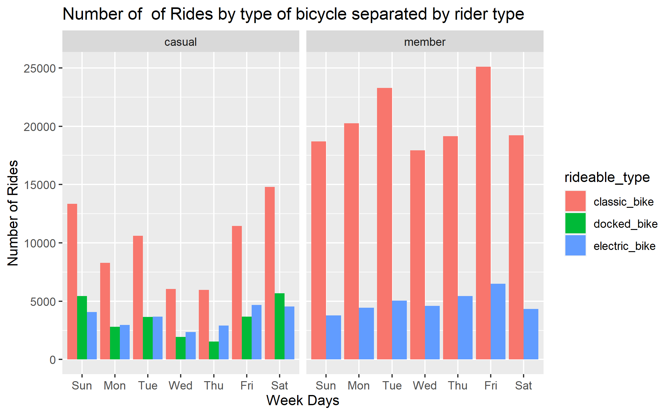
Classic bike is the preference for both type of riders

Slide 8
Recommendation
The marketing team should advertise the benefits for becoming a member on weekends.
Give a 20 – 35% discount to new members that on average travel at least twenty minutes daily.
Increase the amount of classic bike at each bike station.

Slide 9
Questions?

